Slide 1
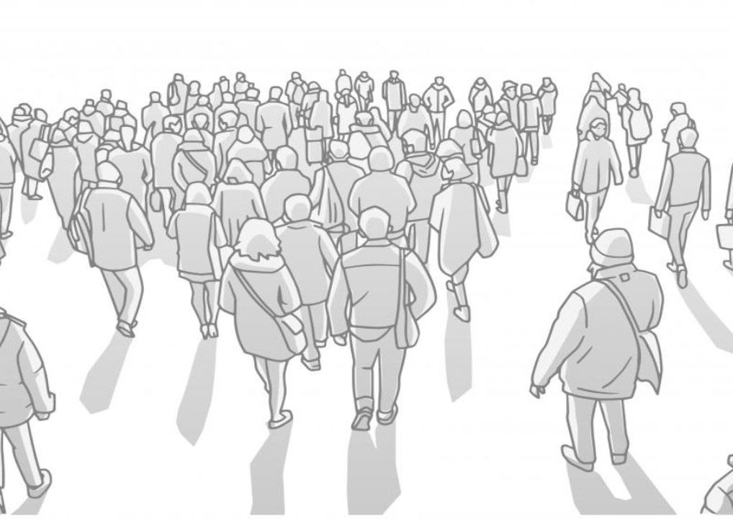
INTERCULTURAL CONSIDERATION

Slide 2

‘”If you talk to a man in a language he understands, that goes to his head. If you talk to him in his language, that goes to his heart,,

Slide 3

Not only language is enough
New communication technologies effect
Using culture in communication is like coloring

Slide 4
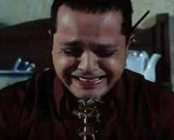
Culture Shock
it is an experience a person may have when one moves to a cultural environment which is different from one's own
Happen because of unfamiliar way of life

Slide 5
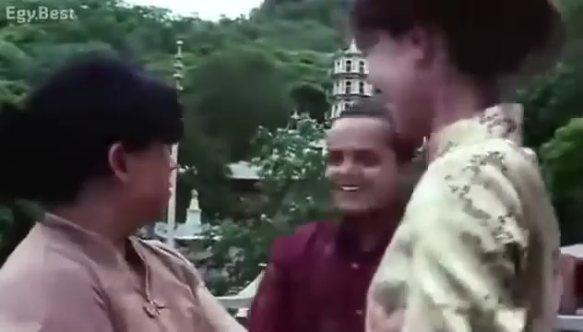
Handle culture Shocks
Research
Accept and adapt
positive attitude
Be Patience
Get into the other persons’ shoes

Slide 6
Stereotype VS Global Culture
Cultural generalizations involve categorizing members of the same group as having similar characteristics.
Cultural generalizations must not be applied to every person within a culture group
EX
Egyptians are great people
People in el-sharkia is very generous

Slide 7
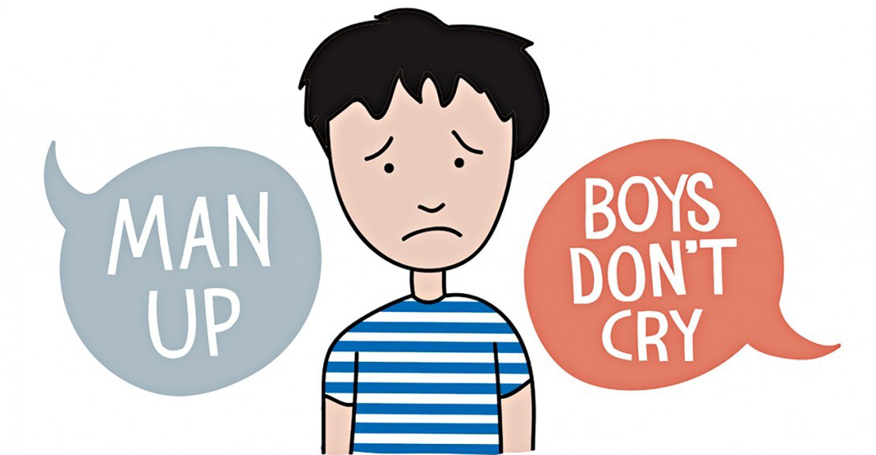
Stereotype VS Global Culture
Generalizations become stereotypes when all members of a group are categorized as having the same characteristics.
Stereotypes, however, tend to be more negative than generalizations. Also, they are typically inflexible and resistant to new information.

Slide 8
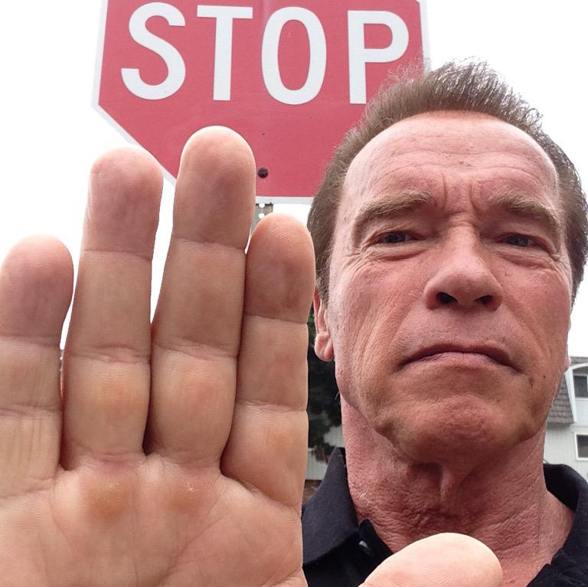
Avoid violation of culture values
Value is used to judge the world around us
Breaking values and traditions is like breaking law
Avoid breaking those values by learn about culture of the people you communicate with .
Notes:
Values :
Shared rules
Used to judge the world around us

Slide 9
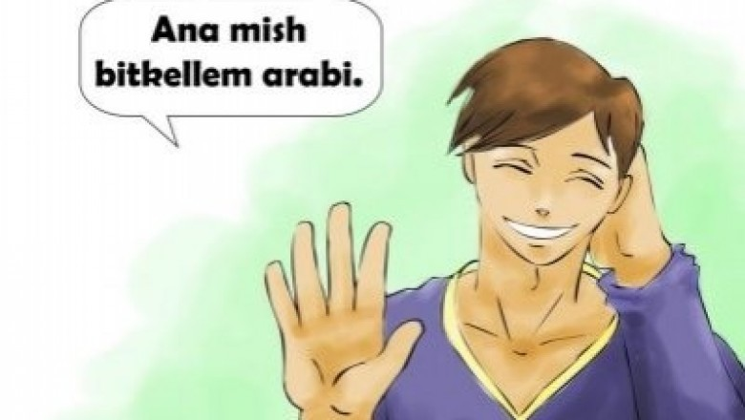
Cultural Slang
A type of language that consists of words that are regarded as very informal, are more common in speech & typically restricted to a particular context or group of people
Importance of slang in languages makes every country unique influenced by history, environment and culture.

Slide 10

Words have different meanings in different groups and cultures
Gamers (as a group) slang
GG – AFK - Bot Frag – Noob

Slide 11




Egyptian slang

Slide 12
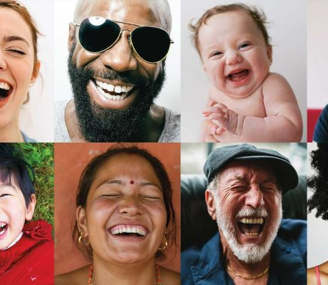
Using Humor
Humor is different from country to country, Language to language.
This is because of social and cultural background of people.
Something you find it funny maybe not to another. It may be even considered offensive.

Slide 13
Influence of cultures on humor
British are sharply sarcastic.
Americans are great at physical comedy.
Egyptian memes & Standup comedy shows.
Korean playing with words and puns.
So .. In conclusion humor can be changed by the interests of the culture and that different cultures will have their own sense of humor.

Slide 14

Gender egalitarianism
Gender egalitarianism believes that men and women, no matter their gender, are equal and must be treated as such. Gender egalitarianism supports equal rights, roles, and responsibilities for men and women.
Notes:
Values :
Shared rules
Used to judge the world around us

Slide 15
How does culture affect gender egalitarianism?
Culture in every society has an impact on the relationship between traditions and the role of gender, and whether society agrees with these needs or notHere, culture plays an important role in how people perceive the role of women in society and that they are able to influence society's goals.According to some studies, Sweden is one of the most gender-equality countries in the world

Slide 16
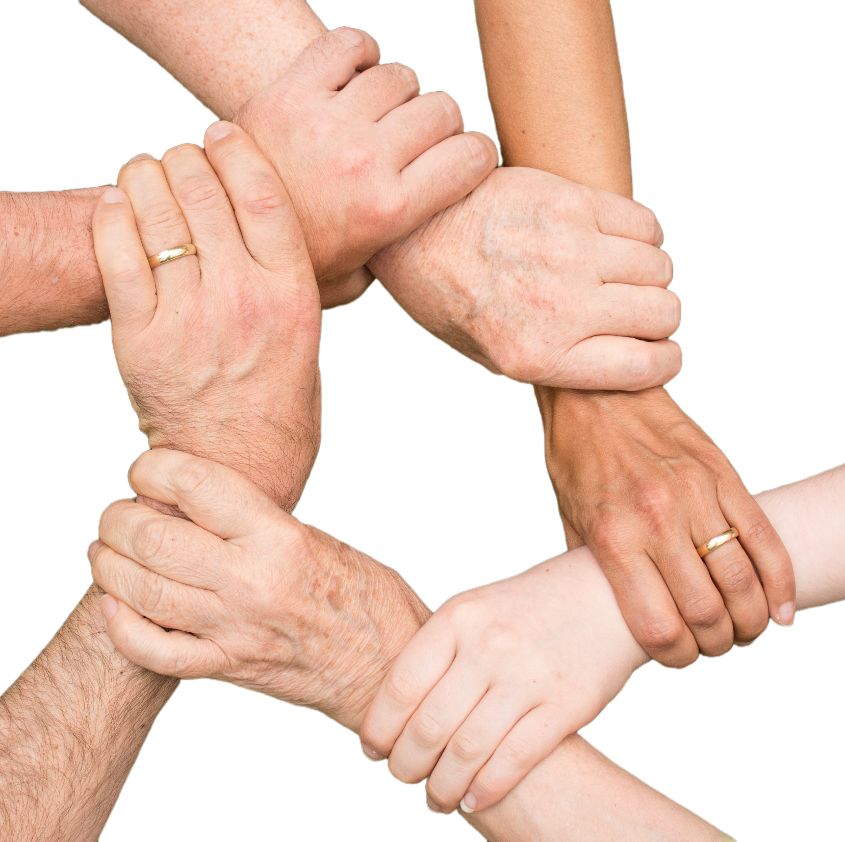
What Is Cultural Variation?
Cultural variation refers to the differences in social behaviors that different cultures exhibit around the world. What may be considered good etiquette in one culture may be considered bad etiquette in another. Cultural variations become obvious when put side by side in large multicultural cities.

Slide 17
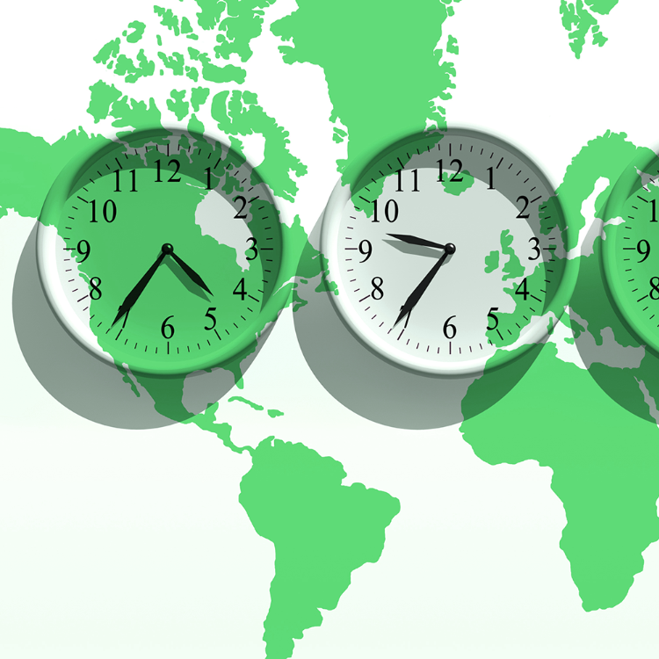
Different time-zones
Working with other cultures: it's about time!
Just as different parts of the world have different time zones, they also have varying perceptions of time. In many cultures, people live in the present. They find the western view of time strange. For example, Arabs call Westerners slaves to the clock. When interacting with other cultures, it's wise to develop your sense of patience.

Slide 18
References
https://www.afsusa.org/study-abroad/culture-trek/culture-points/what-are-generalizations-and-stereotypes
https://www.shorelight.com/student-stories/how-to-deal-with-culture-shock-a-guide-for-international-students/
https://translations.ph/blog/filipino-slang,-colloquialism,-and-its-uses
https://shrehyagarwal.medium.com/intercultural-communication-a-skill-luxury-cannot-oversee-b41452236158
https://www.skillsyouneed.com/general/emotional-intelligence.html

Slide 19
Thank You

